Slide 1



The EISCAT_3D atmosphere and geospace radar: current status and science outlook for meteors
Johan Kero, Daniel Kastinen and Maria Gritsevich
Swedish Institute of Space Physics (IRF), Kiruna, Sweden
with special thanks to staff at the EISCAT Scientific Association
and collaborators world-wide

Slide 2


Slide 3
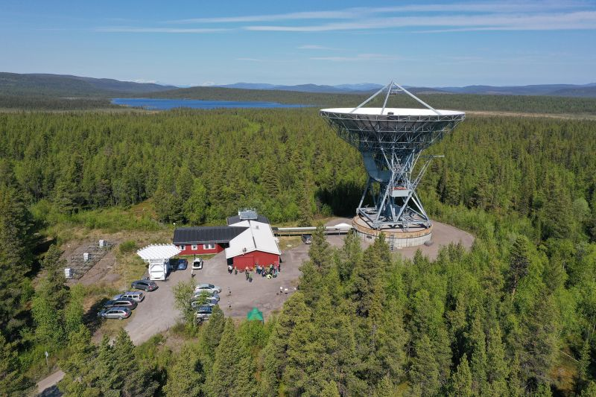


Slide 4
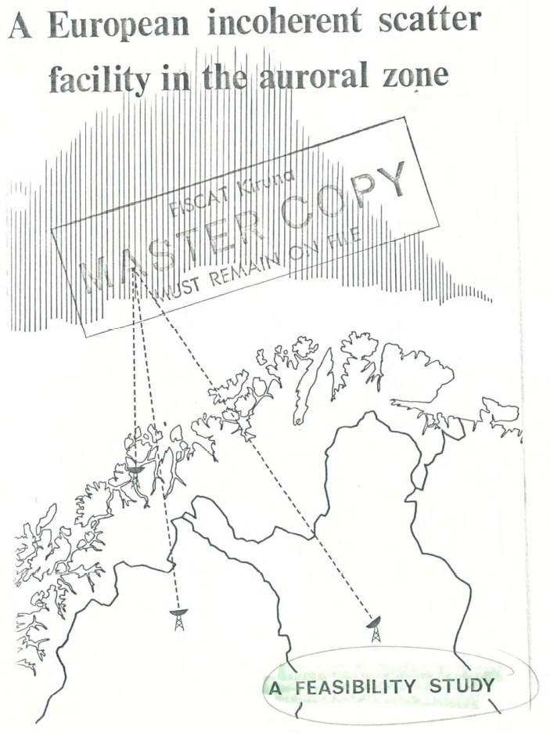






Notes:
To put the project into context lets first go back to where it started.
In the sixties Sweden, Norway, Finland, UK, Germany and France conducted a feasibility study which was published in 1971. The goal was to find an international agreement to construct an incoherent scatter radar in the auroral zone.

Slide 5
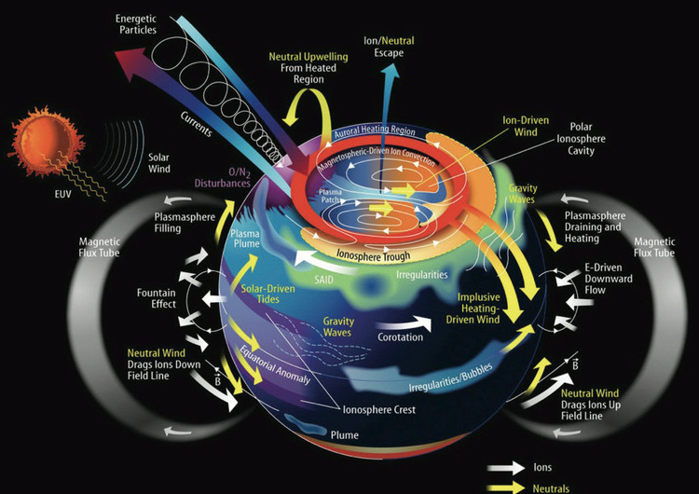
The complex atmosphere-ionosphere-magnetosphere system
Image credit: J. Grebowski / NASA GSFC

Slide 6
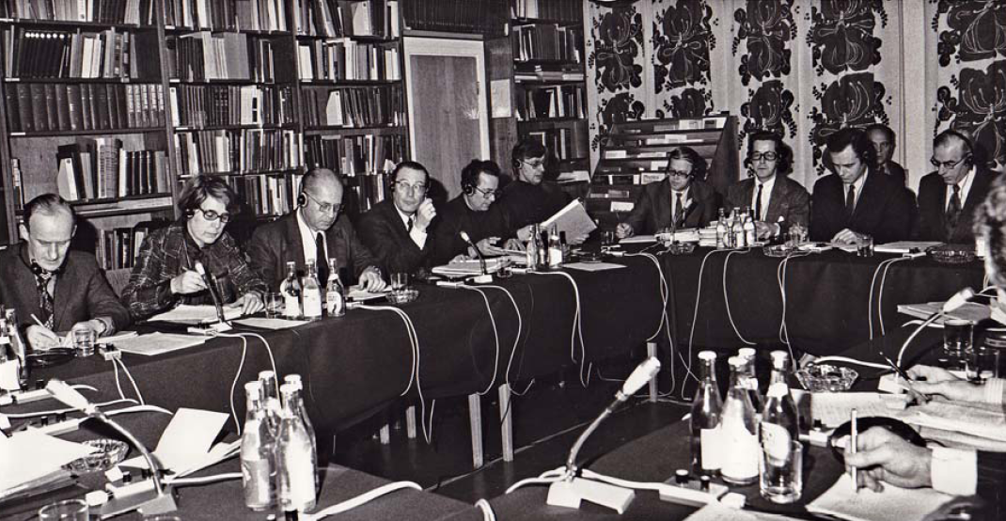
First EISCAT Council meeting
20 January 1976, Kiruna
Notes:
It took five years to reach a funding agreement. EISCAT was registered as a non-profit organization in Sweden in 1976 with a council of representatives from the six European countries. It took another five years to construct the first radar system, the tristatic UHF radar which has been in operation since 1981.

Slide 7


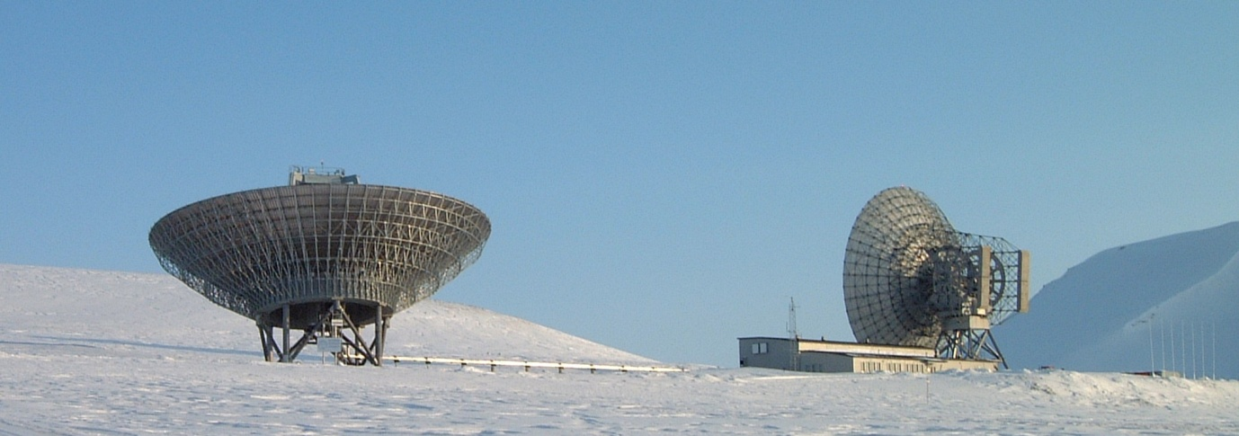
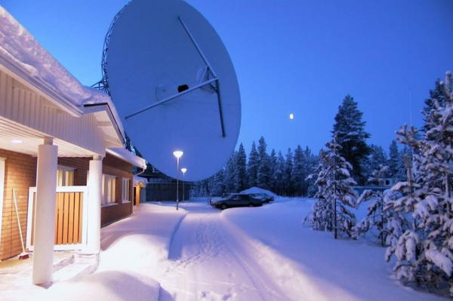
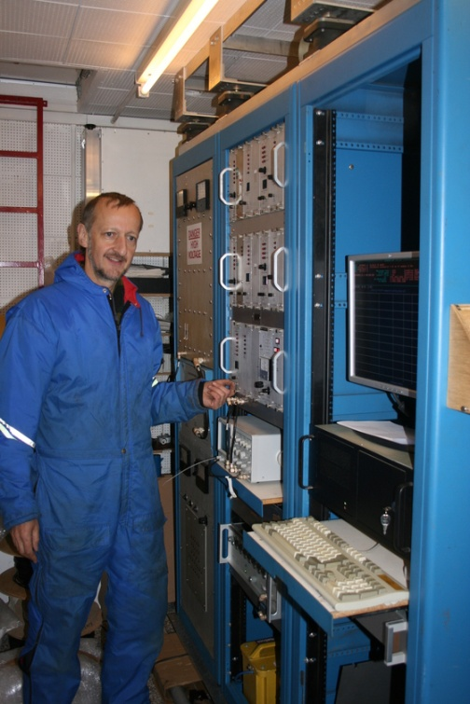
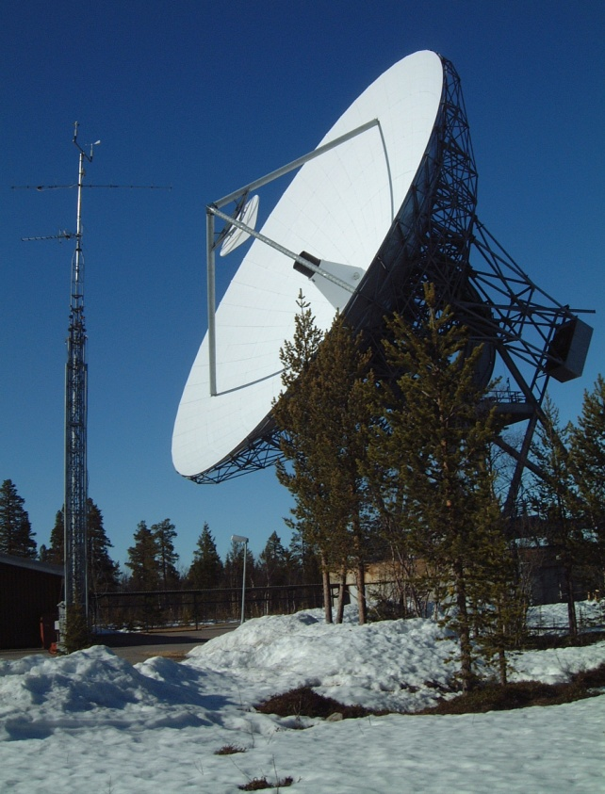
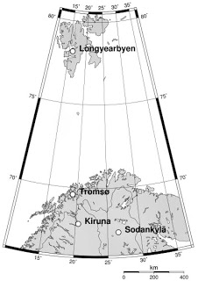
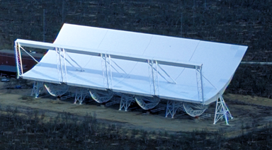
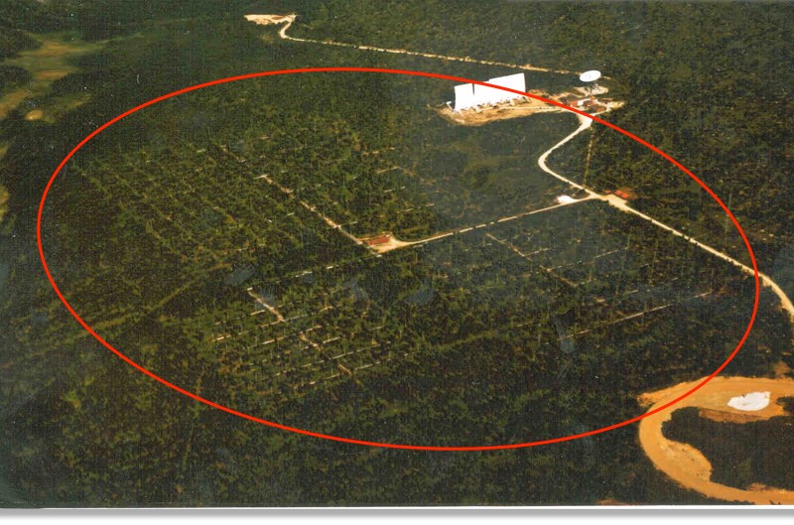
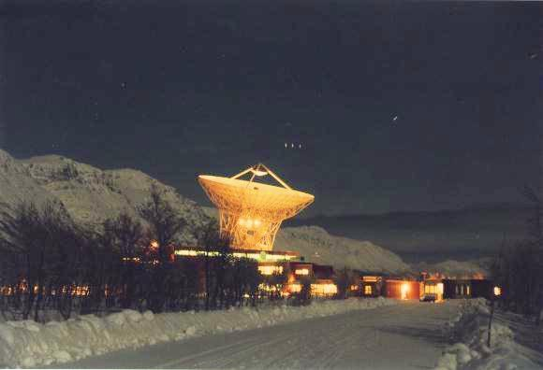
Current EISCAT research radar systems
Current associate countries:
Longyearbyen 500 MHz
Sodankylä
VHF
Kiruna
VHF
2 dynasonds:
Longyearbyen
Tromsö
Tromsö
224 MHz VHF
Tromsö
930 MHz UHF
Tromsö ionospheric heater
Notes:
More radar systems have been constructed along the way and this is the set of radars available today. Germany and France have left the association but Japan and China have joined.
So it is now international rather than European. In addition to associated countries with representatives in the council, there are also affiliate institutes in France, Ukraine and South Korea that pay for radar time but not for full membership.
The council appoints a director who is responsible for the facilities and the staff. The current director is Craig Heinselman who joined EISCAT in 2013, coming from SRI international in the US.

Slide 8
Falck och Snickars,
KTH, 2013
IRF
Falck & Snickars, 2013
Notes:
The EISCAT user community is global. Here is a map of the users over an eight-year period. In addition to collaborating with scientists in the member countries to get hold of special program data it is possible for anyone to use common program data available online and to apply for transnational access.

Slide 9



EISCAT_3D Design Study 2004-2009 and
The European Research Infrastructure Roadmap
Notes:
Plans for a new system started around twenty years ago In 2004 EISCAT started an EU funded Design Study together with the user community to define the baseline of a new radar. The radar was named EISCAT_3D. In 2008 the project was selected for inclusion on the European Strategy Forum Roadmap to Research Infrastructure where it has been since. This has enabled further EU funding to develop the concept.

Slide 10
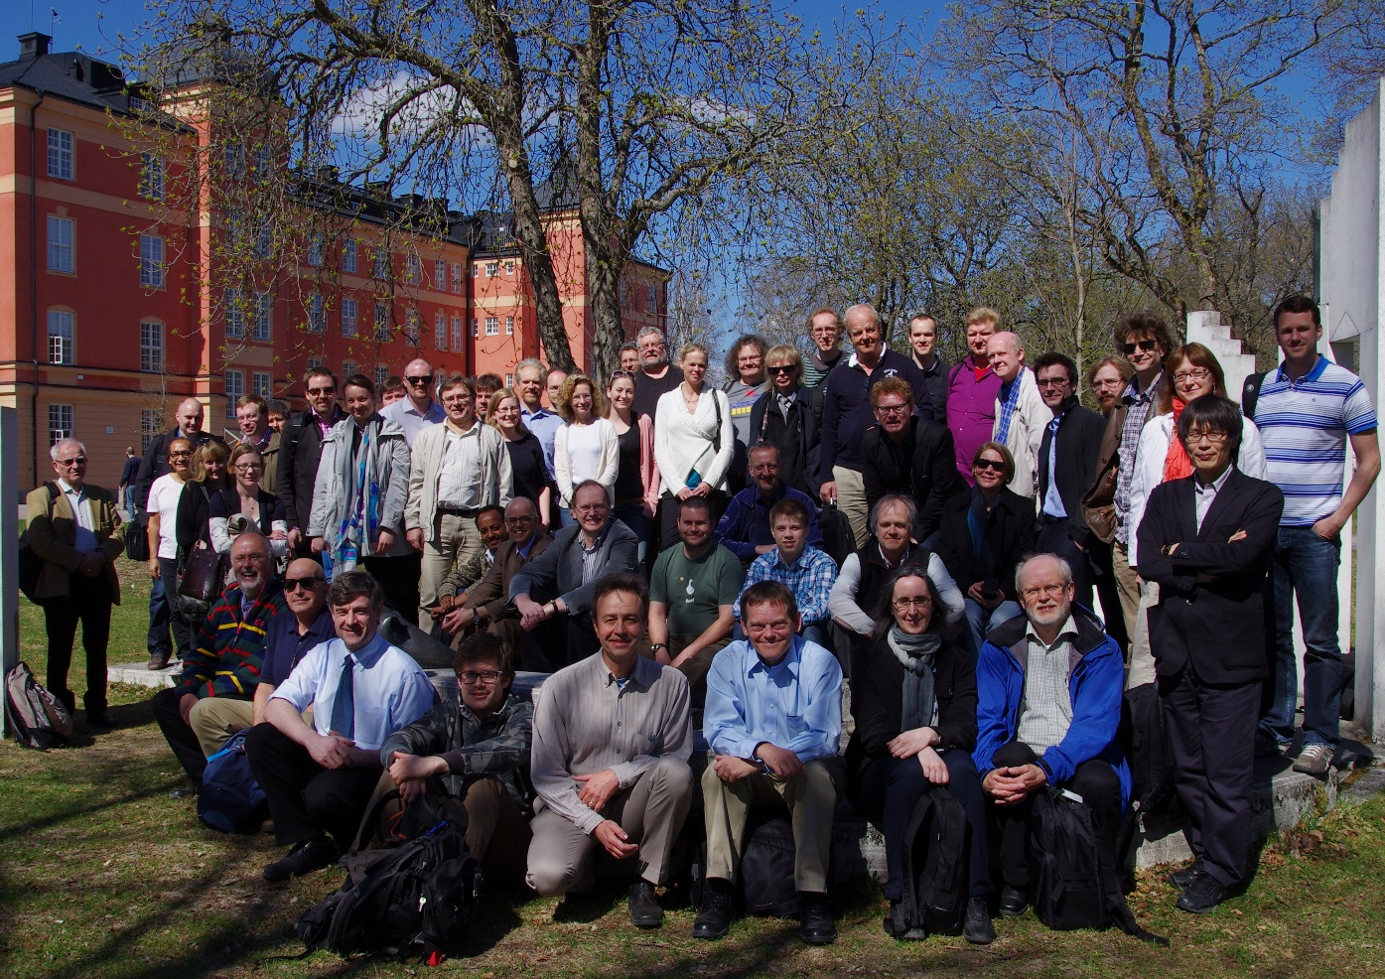
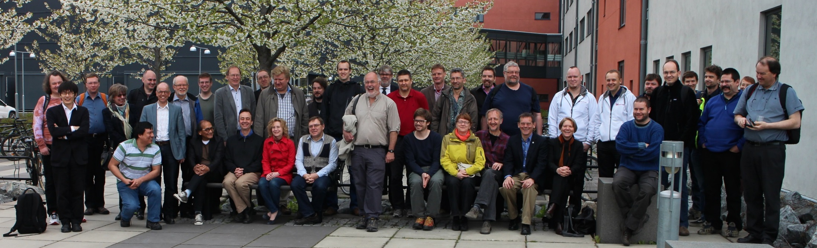
Annual international EISCAT_3D
User Meetings in Uppsala since May 2009
2013
2014
Notes:
In the meantime the scientific user communities in several of the member countries applied for national funding to the construction. There are annual User Meetings in Uppsala every May Especially 2013 and 2014 were important to reach consensus between the countries.

Slide 11
EISCAT_3D Stage 1
5 MW pulsed transmitter power
233 MHz operating frequency
3 phased array receiver sites
10,000 antenna elements per site
10 outrigger subgroups near transmitter
Dual polarization
30 MHz receiver bandwidth
100 beams per site
Phase steerable to 60° off zenith
Interferometry
Continuous operations
Multi-purpose experiments
1-25% duty cycle
Notes:
The baseline design of what is now called EISCAT_3D stage 1 is a tristatic system

Slide 12
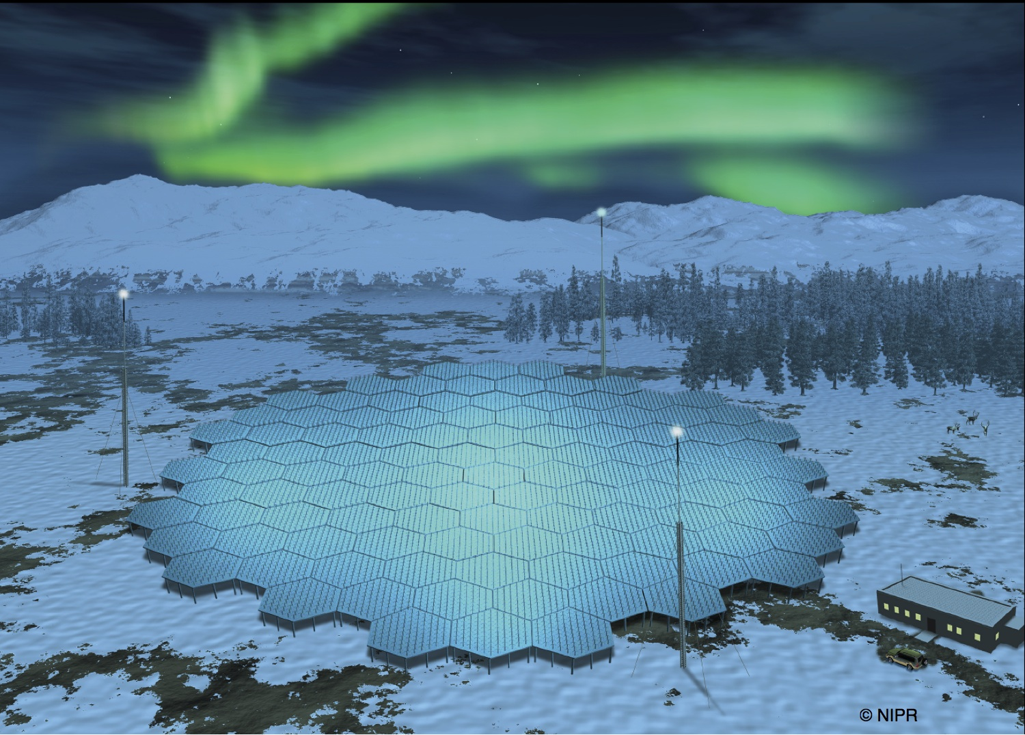
Artist impression of an EISCAT_3D site
Notes:
For space debris measurments, ionospheric corrections need to be applied due to the operating frequency at 233MHz. The elctron density profile is measured but uncertainties may be large due to strong gradients in active conditions

Slide 13
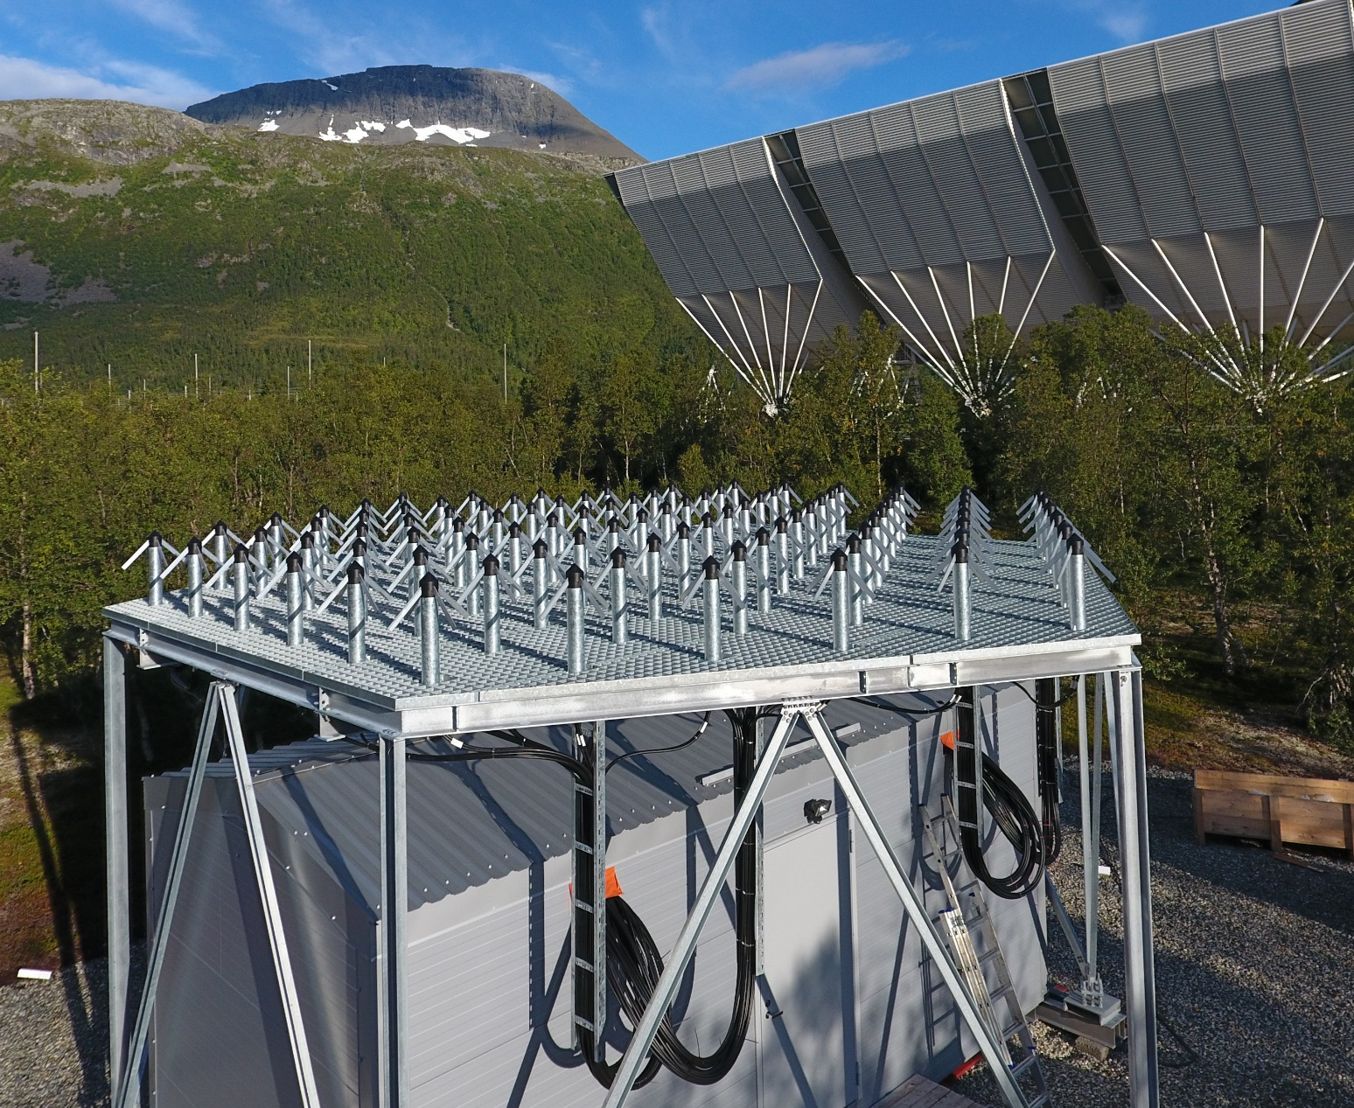
Preparation for Production 2015-2017

Slide 14
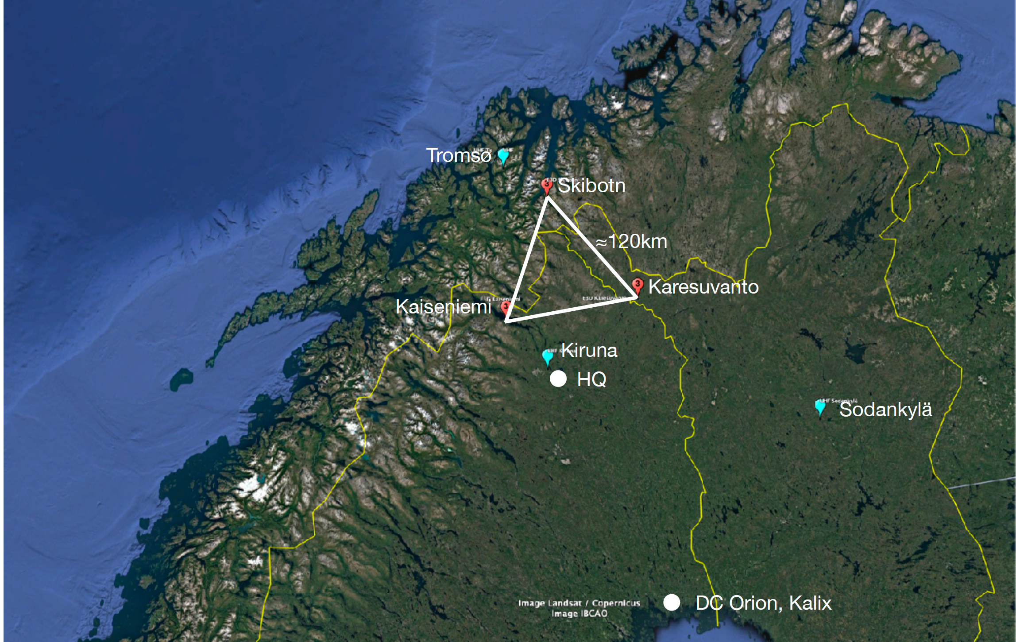
Stage 1 construction 2017-2024
Notes:
150 km baselines between sites. Full state vector measurement of meteors and space debris already from single measurement points.

Slide 15
EISCAT_3D Stage 1
3.7 MW pulsed transmitter power
233 MHz operating frequency
3 phased array receiver sites
10,000 + 5,000 + 5,000 elements per site
10 outrigger subgroups near transmitter
Dual polarization
30 MHz receiver bandwidth
100 beams per site
Phase steerable to 60° off zenith
Interferometry
Campaign operations
Multi-purpose experiments (?)
1-25% duty cycle
Notes:
The baseline design of what is now called EISCAT_3D stage 1 is a tristatic system

Slide 16
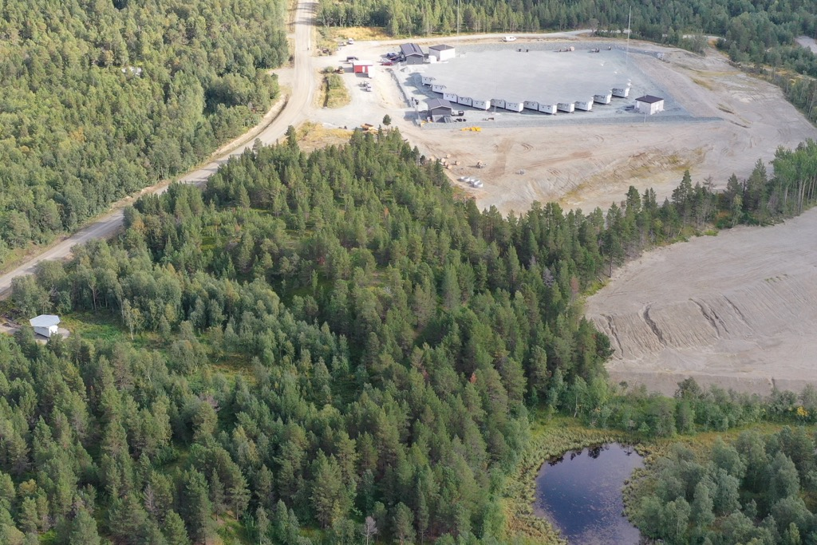
EISCAT_3D, Skibotn, Norway
Notes:
The baseline design of what is now called EISCAT_3D stage 1 is a tristatic system

Slide 17
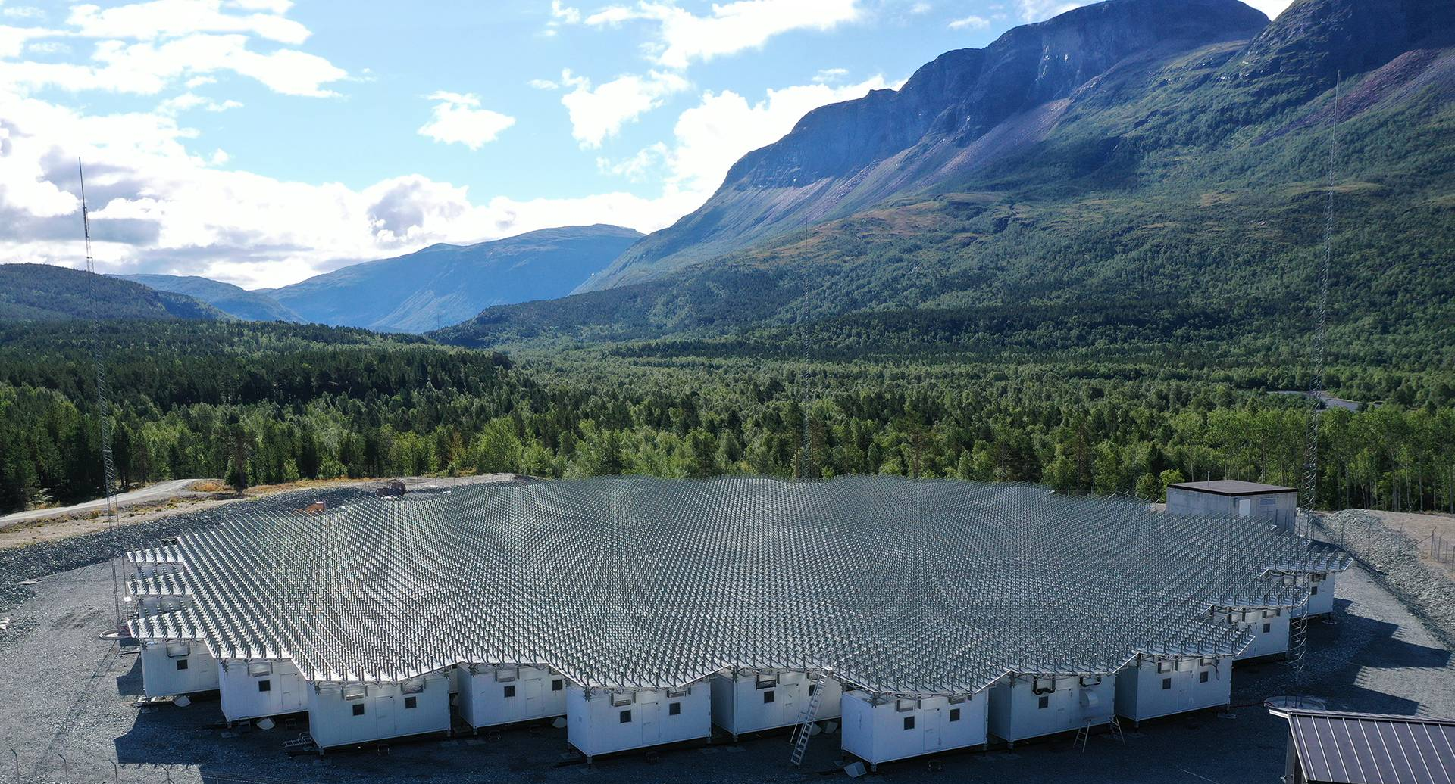
EISCAT_3D, Skibotn, Norway
Notes:
The baseline design of what is now called EISCAT_3D stage 1 is a tristatic system

Slide 18
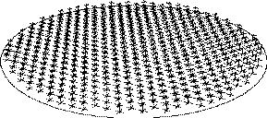
Meteor head and trail echoes
Electrons in the plasma around the meteoroid or the trail scatter radio waves
Meteor trail
.
.
.
Motion of meteoroid
.
。
.
。
。
。
.
.
。
.
.
。
.
.
。
.
.
.
.
。
。
。
。
。
Meteoroid
.
.
。
.
.
.
。
。
。
。
.
。
.
。
.
.
。
.
.
。
.
.
.
10-70km/s
.
。
。
electron
。
.
。
.
.
.
。
。
.
.
.
.
.
。
。
.
。
。
。
.
.
.
。
。
.
.
.
.
.
.
。
.
.
.
.
.
。
.
.
Positive ion
Meteor trail echo
Dense plasma (meteor head)
Meteor head echo
High Power Large Aperture radar
e.g. MU, MAARSY, EISCAT,…
Specular meteor radar e.g. SKiYMET, ATRAD
18

Slide 19
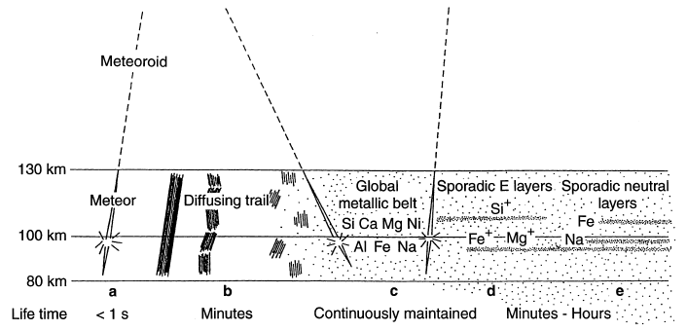
Pellinen-Wannberg et al. 1998

Slide 20
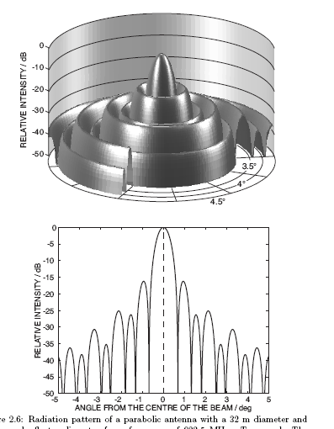
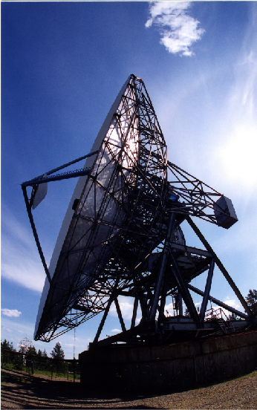
Figure 2.6 from Nygrén, T. (1996), Introduction to incoherent scatter measurements, 1st ed., Invers, Sodankylä, Finland

Slide 21
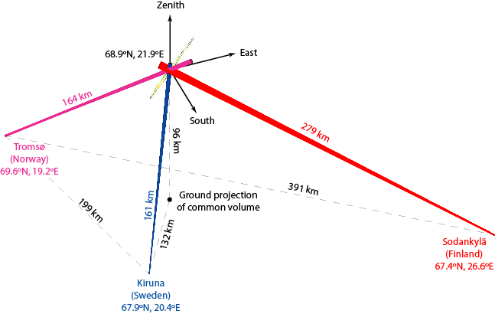

Slide 22
KIRUNA:
SODANKYLÄ:
TROMSØ:

Slide 23
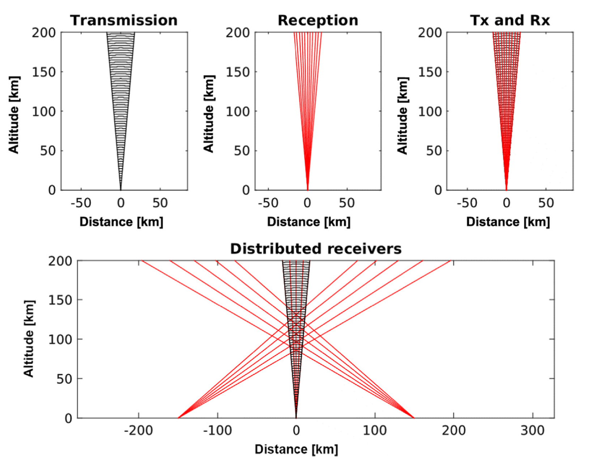
Eiscat_3d multistatic meteor observations
Pellinen-Wannberg et al. 2016

Slide 24
KARESUVANTO:
KAISENIEMI:
SKIBOTN:

Slide 25
Meteoroid velocity

Slide 26
velocity = 63.7 km/s; zenith angle = 49.9º
mass = 9·10⁻⁹ kg; radius = 90 μm; (if spherical and density = 3.3 g/cm³)

Slide 27
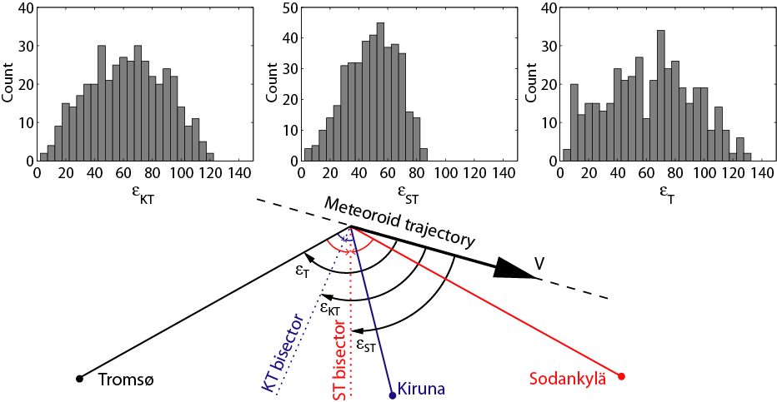
Head echo aspect independence
Kero et al., 2008

Slide 28
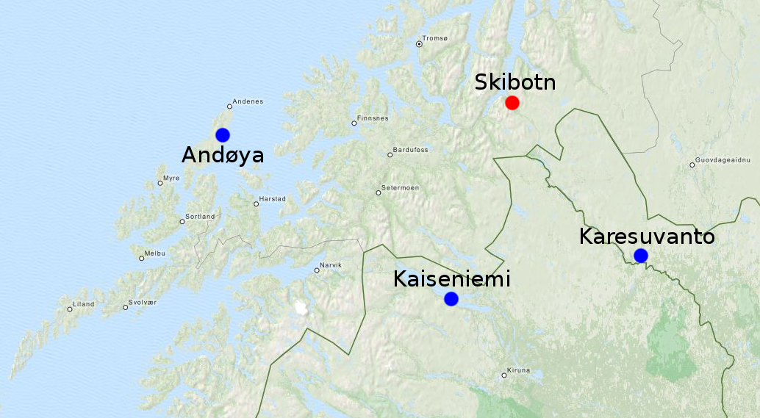
MAARSY and EISCAT_3D
Pointing MAARSY east at 60° elevation:
Skibotn >30° at >80 km altitude
Kaiseniemi >30° at >85 km altitude
Karesuvantu >30° at >125 km altitude

Slide 29
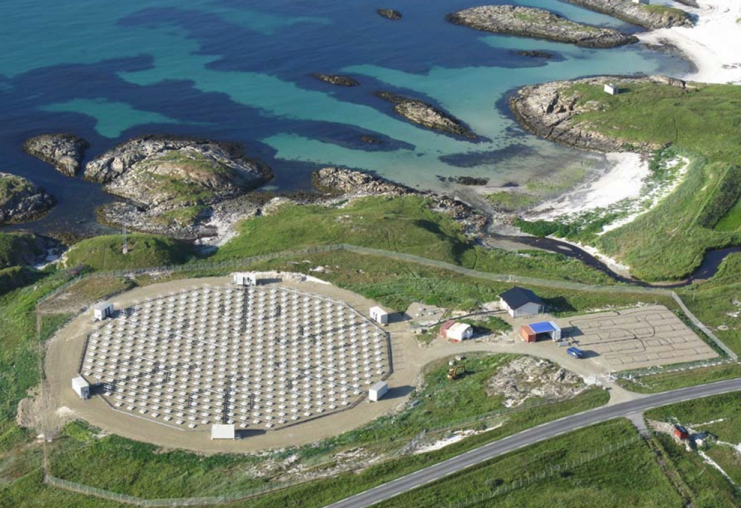
Middle Atmosphere Alomar Radar System
(MAARSY)
Hardware Specification
Frequency | 53.5 MHz
Power | ~866 kW
Antennas | 433 3-element (crossed) Yagi Antennas
Gain | 33.7 dBi
Aperture | ~6300 m²
Beam width | 3.6°
Beam steering capabilities | freely steerable with 35° off-zenith
Receiver channels | 16
29
MAARSY on Andöya, IAP Kühlungsborn
Notes:
MAARSY
- active phased array antenna
- each antenna freely adjustable in frequency, power and phase
multi-channel reciever system for high flexibility on reception

Slide 30
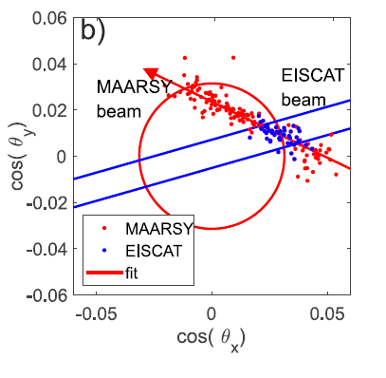
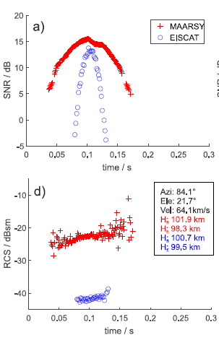
Dual frequency radar observations
Schult et al., 2021

Slide 31
summary
EISCAT_3D will provide multistatic observations
Scattering models can be used to estimate meteoroid masses from head echoes
Multi-frequency observations (EISCAT+MAARSY) can constrain scattering models
EISCAT_3D low-power mode:
~10 pulses per second
Typically one data point per meteor
Velocity and radiant for individual meteors + statistical altitude and RCS (mass)
Enables statistical surveys, detecting meteor shower outbursts, interstellar meteors(?)
EISCAT_3D high-power mode:
>100 pulses per second
Time profiles of velocity, altitude, RCS (mass) for individual meteors
Unprecedented orbit accuracy for low-mass meteoroids
True (unambiguous) altitude distribution
Enables studying fragmentation, differential ablation, initial mass, etc.

Slide 32
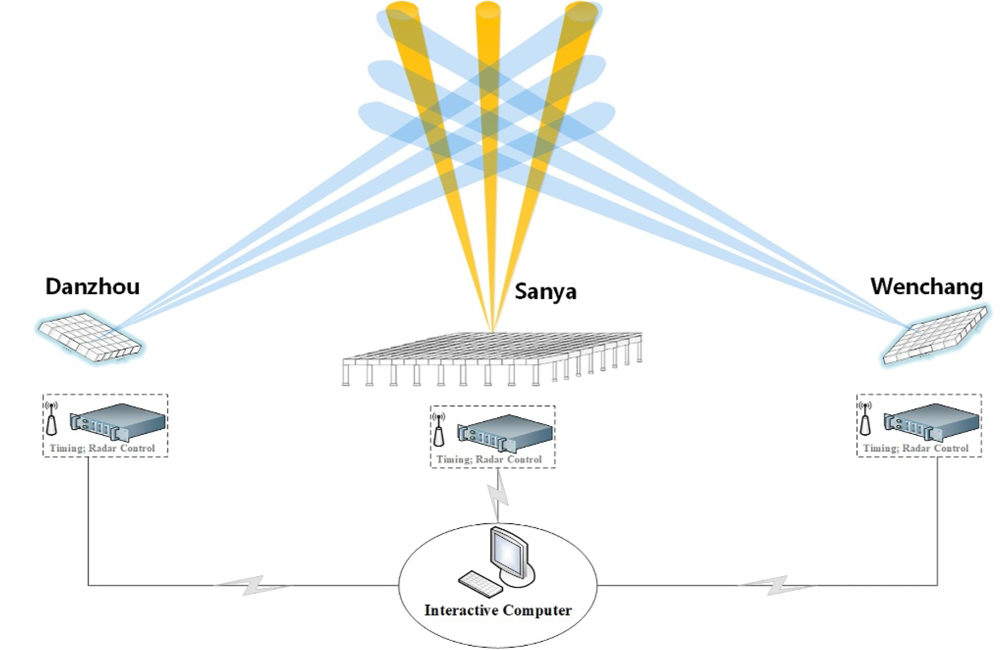
Sanya Incoherent Scatter Radar Tristatic System (SYISR‐TS)
Yue et al. 2024

Slide 33
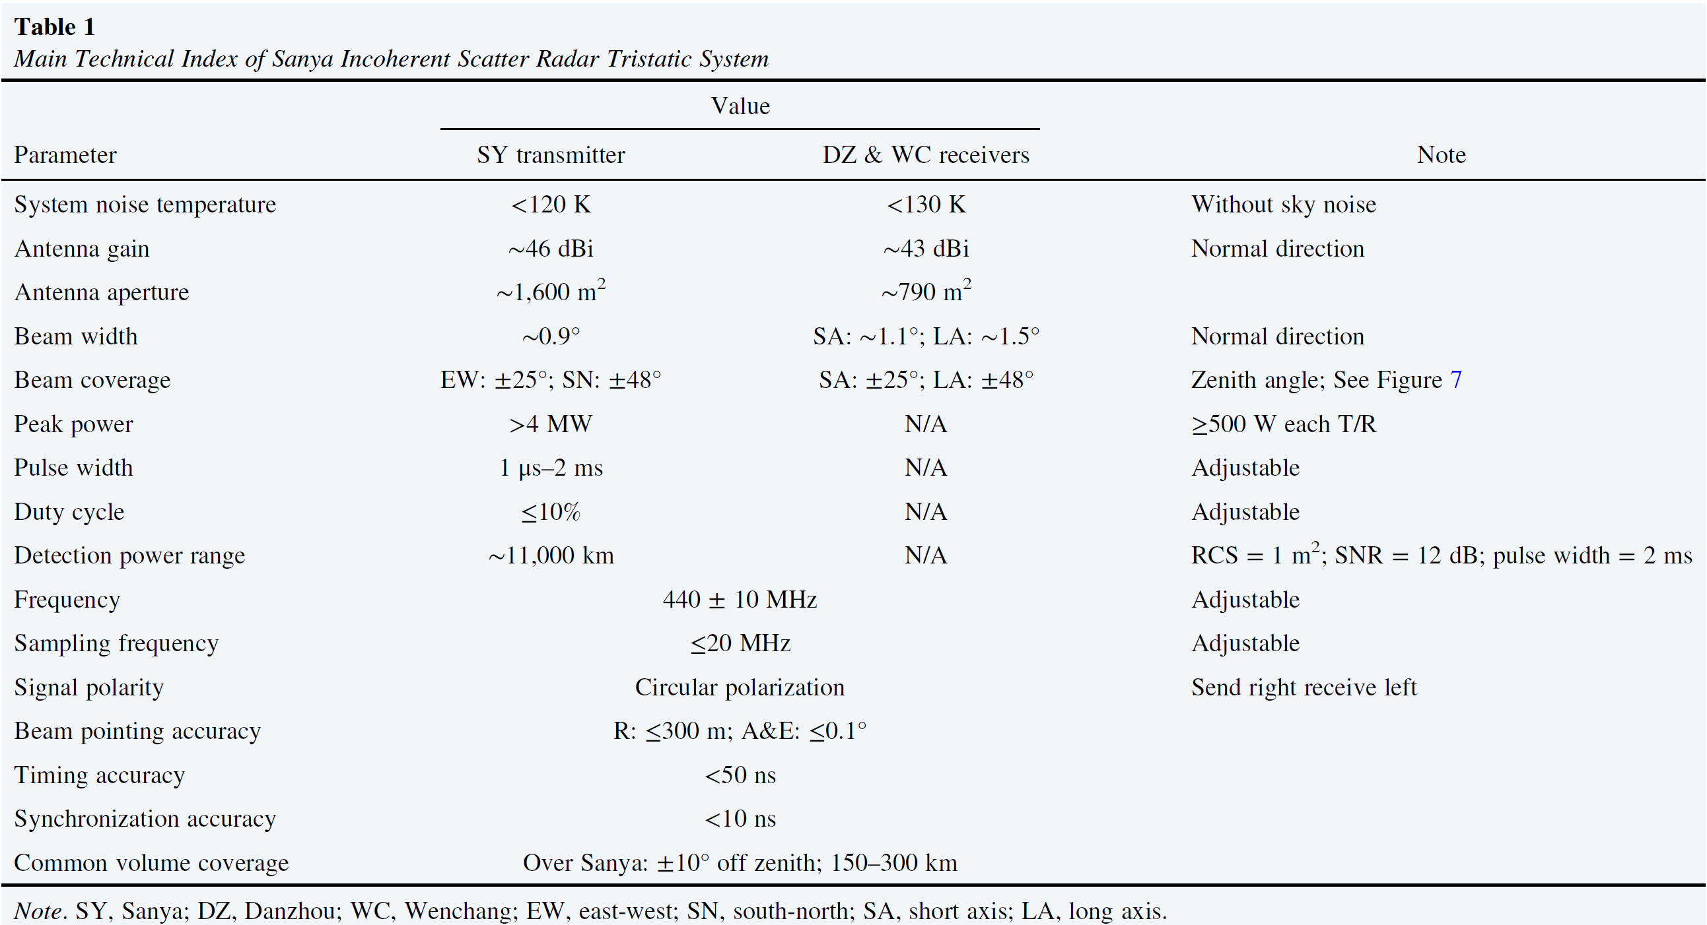
Sanya Incoherent Scatter Radar Tristatic System (SYISR‐TS)
Yue et al. 2024

Slide 34
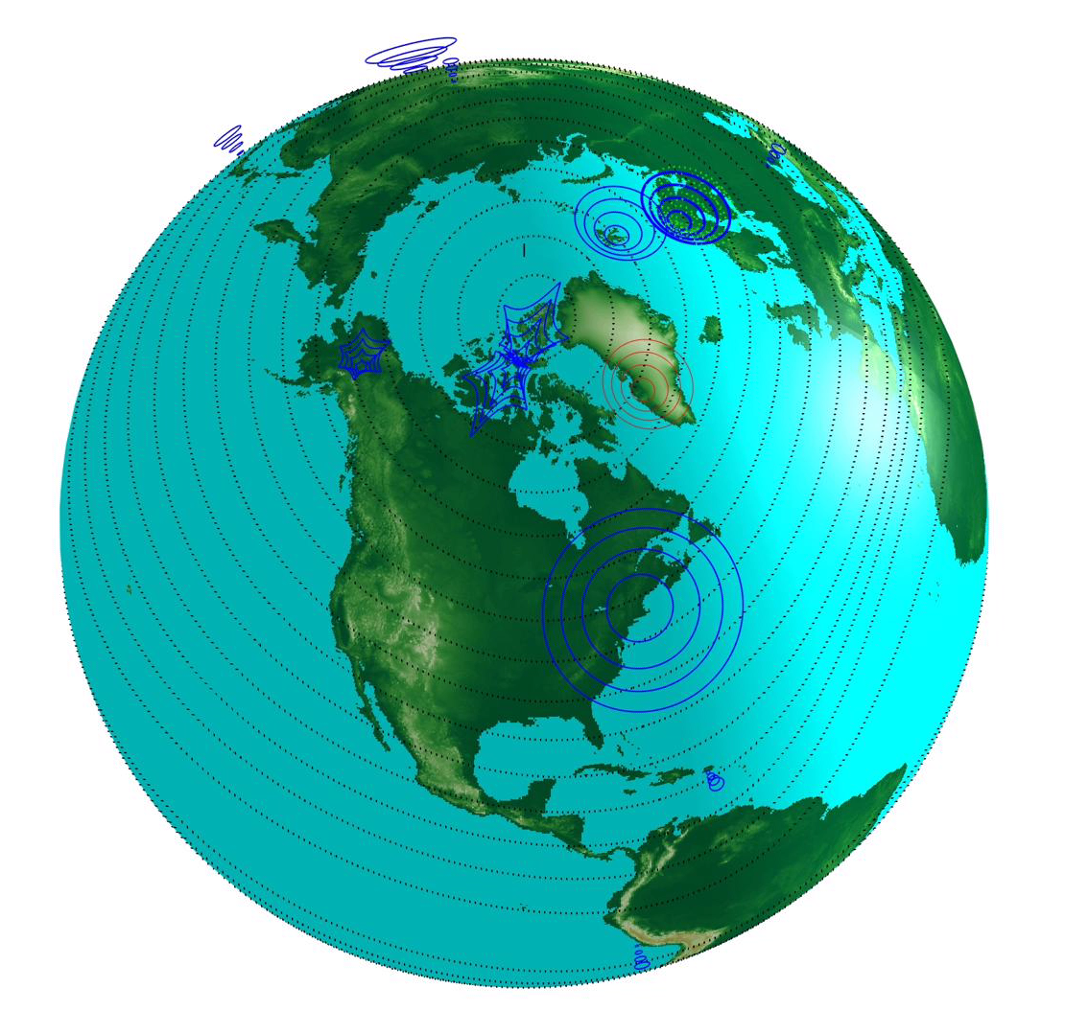
High-Power Large-Aperture radars
Depicted here:
Incoherent scatter
radar systems
in operation in 2019
(Craig Heinselman)

Slide 35
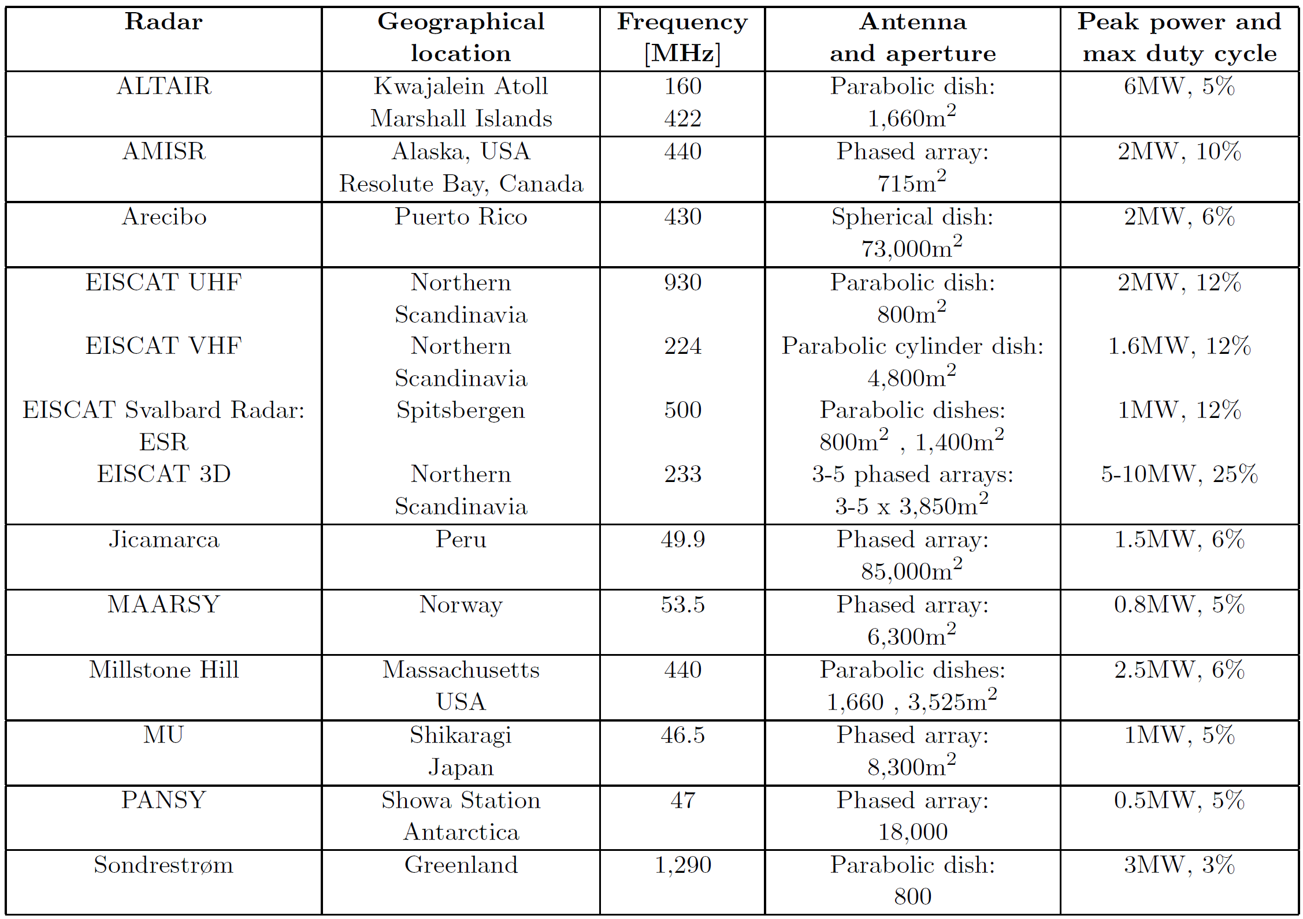
Kero et al. 2019

